Slide 1
Energy and Computation: Flops/Watt and Watts/Flop
Solar Cell Scaling
The Center for Bits and Atoms - MIT
Dr. Alf Bjørseth
Scatec AS
May 10th, 2006

Slide 2
Alf Bjorseth
Ph.D. in physical chemistry – University of Oslo, Norway
Section Manager, Battelle Columbus Labs.
Adjunct Professor, Industrial Chemistry, Univ. of Bergen, Norway
Corporate director of R&D – Norsk Hydro
Director of Technology – Elkem
Founded SCATEC
- PhotoCure (Photodynamic therapy)
- Renewable Energy Corporation (REC) (IPO May 9th ‘06)

Slide 3
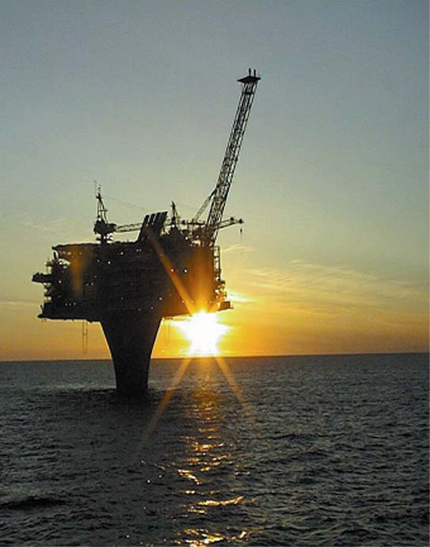
Global energy consumption 1850 - 2030 and CO₂ emmissions 1970 - 2020
Mtoe
MtCO₂
18000
Nuclear
40000
35000
30000
25000
20000
15000
10000
16000
14000
Renewable
12000
Fossil
10000
8000
6000
4000
2000
Kilde: IEA WEO 2002, BP, WEC
0
1850
1900
1950
2000
2030

Slide 4
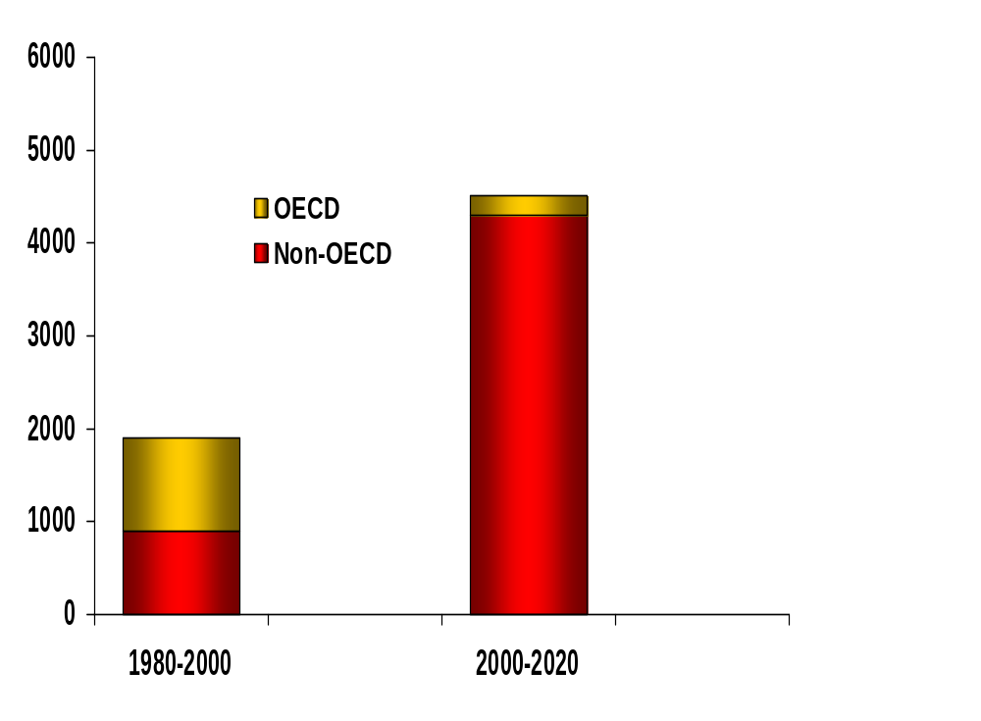

Growth in global energy consumption
Mtoe
Source: IEA WEO 2002

Slide 5
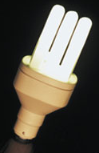
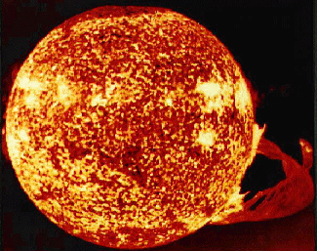
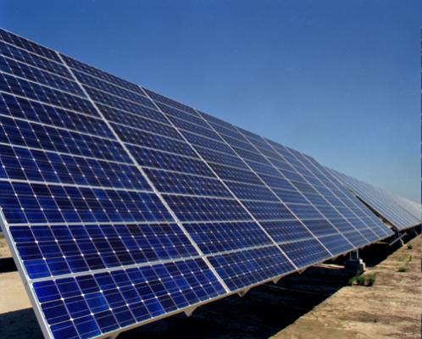
The Sun as Energy Source
The Sun daily provides about 10 000 times more energy to the Earth than we consume
Photovoltaic technology directly converts solar energy into electricity
No moving parts – no noise – no emissions – long lifetime
Large industrial potential - cost reductions needed
Feedstock for PV industry is silicon - the second most abundant element in the crust of the Earth

Slide 6
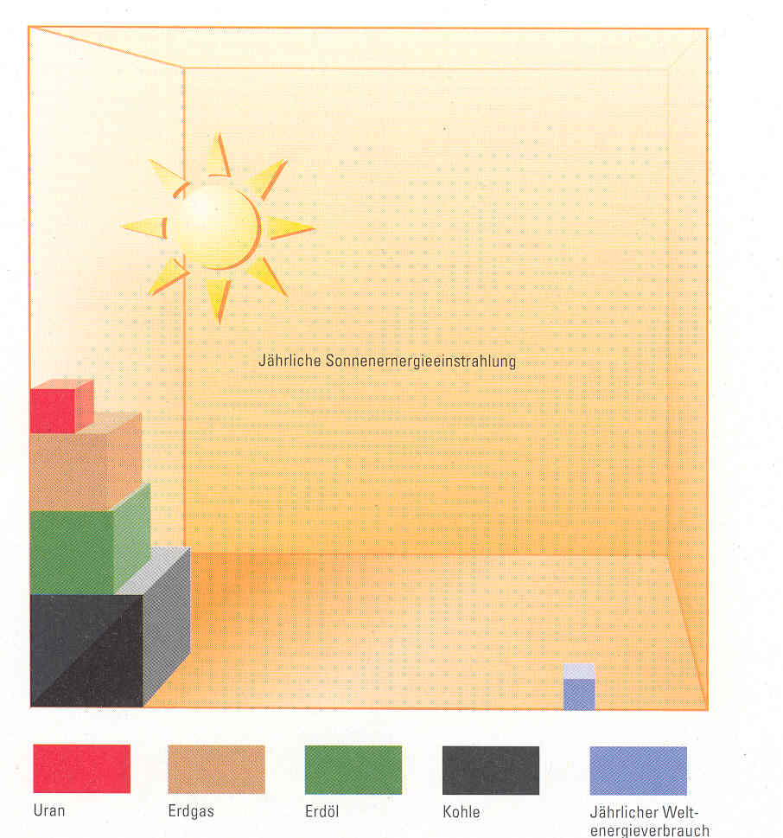
Global Energy Situation
Equivalent Stock of Energy Source
Annual Energy from the Sun
Uranium
Natural Gas
Oil
Coal
Annual Energy Demand

Slide 7
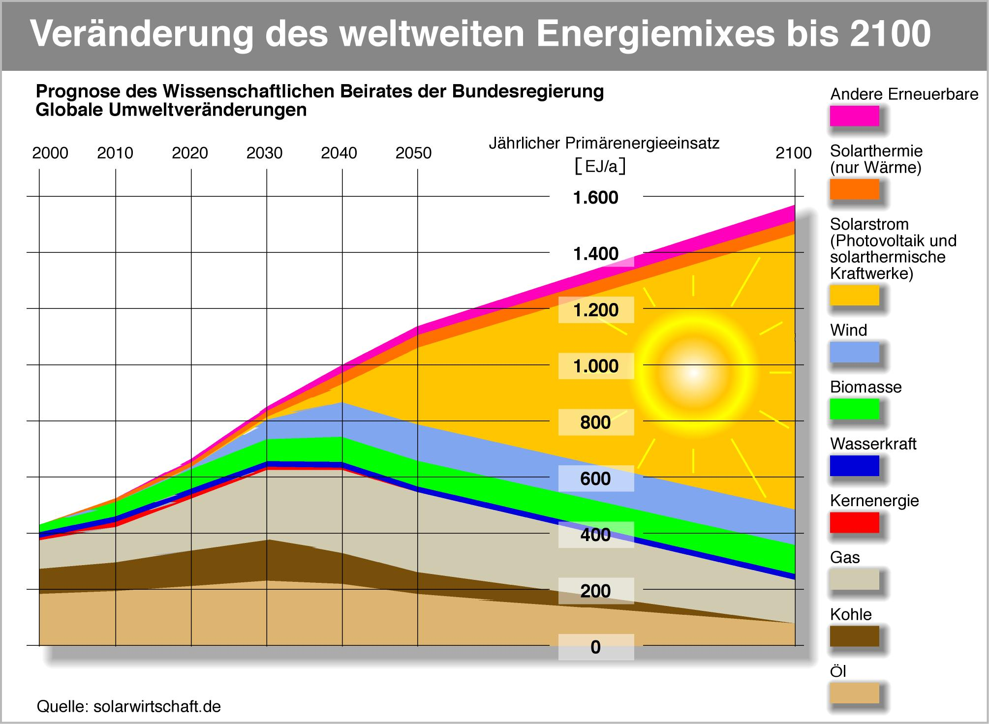
Future energy mix

Slide 8
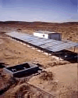



Main Application Areas – Off-grid
Space
Water Pumping
Telecom
Solar Home Systems

Slide 9
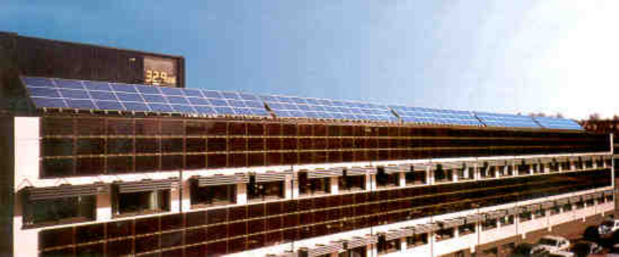

Main Application Areas
Grid Connected
Commercial Building
Systems (50 kW)
Residential Home
Systems (2-8 kW)
PV Power Plants
( > 100 kW)

Slide 10
Solar Energy status
Market is exploding
The solar industry is very profitable
Lack of highly purified silicon (polysilicon)
Cost of solar electricity is too high, R&D focus on reducing cost and increasing efficiency

Slide 11
Solar Energy status
Market is exploding
The solar industry is very profitable
Lack of highly purified silicon (polysilicon)
Cost of solar electricity is too high, R&D focus on reducing cost and increasing efficiency

Slide 12
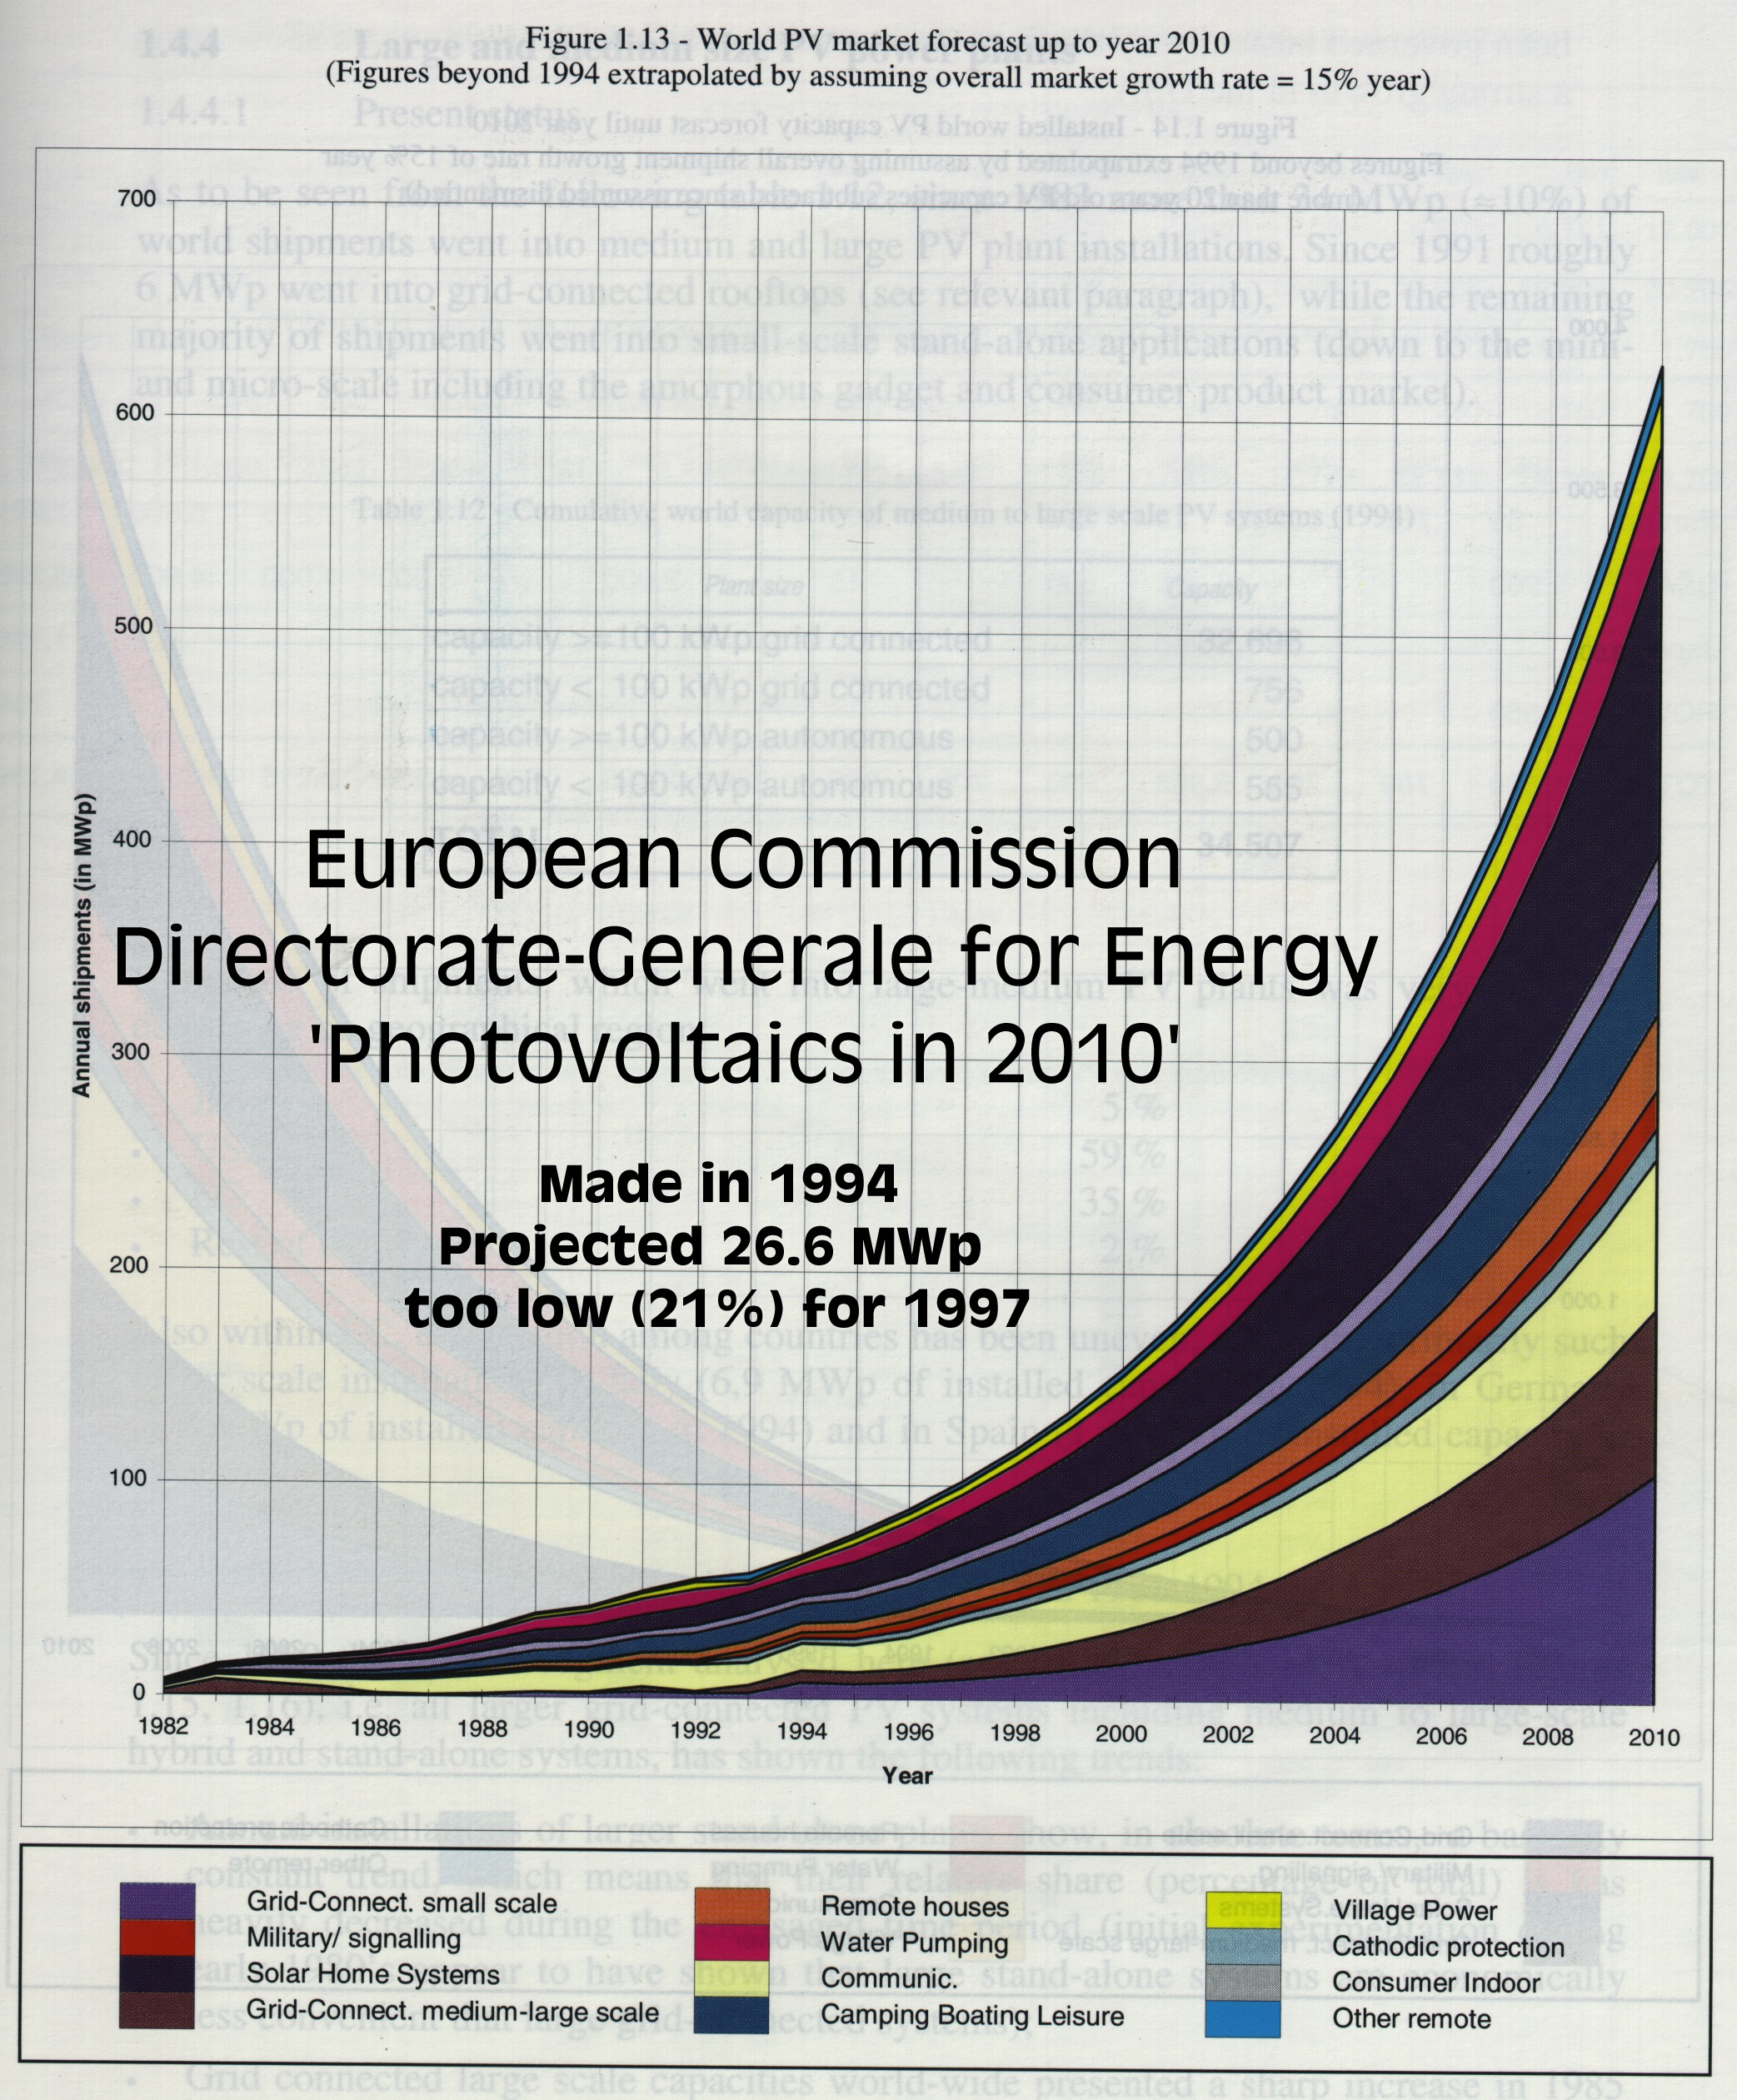
Actual Growth vs. Historic Forecasts
Actual market development

Slide 13
Solar Energy status
Market is exploding
The solar industry is very profitable
Lack of highly purified silicon (polysilicon)
Cost of solar electricity is too high, R&D focus on reducing cost and increasing efficiency

Slide 14
RECs - Gross revenue development
2454
1800
(MNOK)
1600
1705
1400
1200
1000
857
800
600
435
400
200
159
0
2001
2002
2003
2004
2005

Slide 15
RECs - EBITDA development (MNOK)
250
830
200
155
150
100
50
0
2001
2002
2003
2004
2005
-50
-17
-35
-32

Slide 16
Solar Energy status
Market is exploding
The solar industry is very profitable
Lack of highly purified silicon (polysilicon)
Cost of solar electricity is too high, R&D focus on reducing cost and increasing efficiency

Slide 17
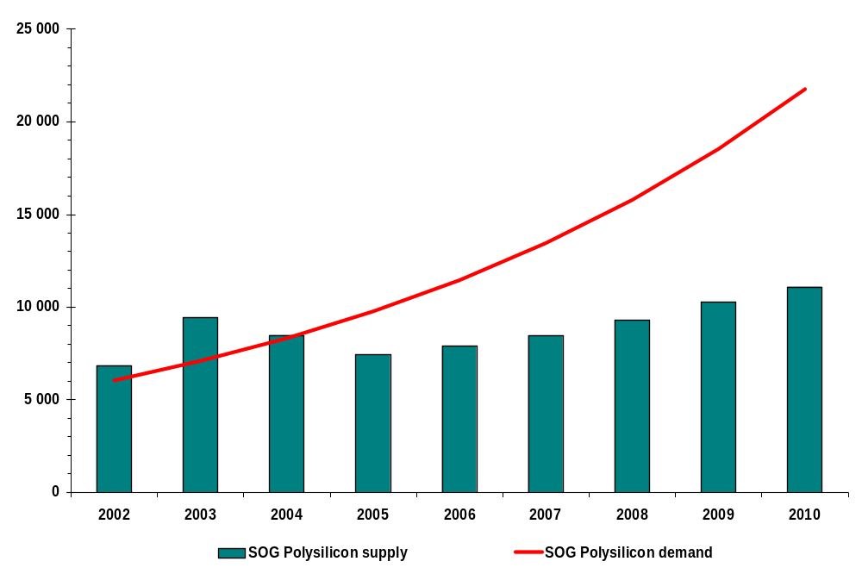
Solar Grade Silicon Supply-Demand (MT/year)

Slide 18
Solar Energy status
Market is exploding
The solar industry is very profitable
Lack of highly purified silicon (polysilicon)
Cost of solar electricity is too high, R&D focus on reducing cost and increasing efficiency

Slide 19
Cost reductions – existing technologies
Thinner wafers
- Wire sawing
- Laser cutting and etching
Higher efficiencies
- Semiconductor technologies on single
crystal wafers (examples Sanyo / SunPower)
Thin film technologies (flat panel display)

Slide 20
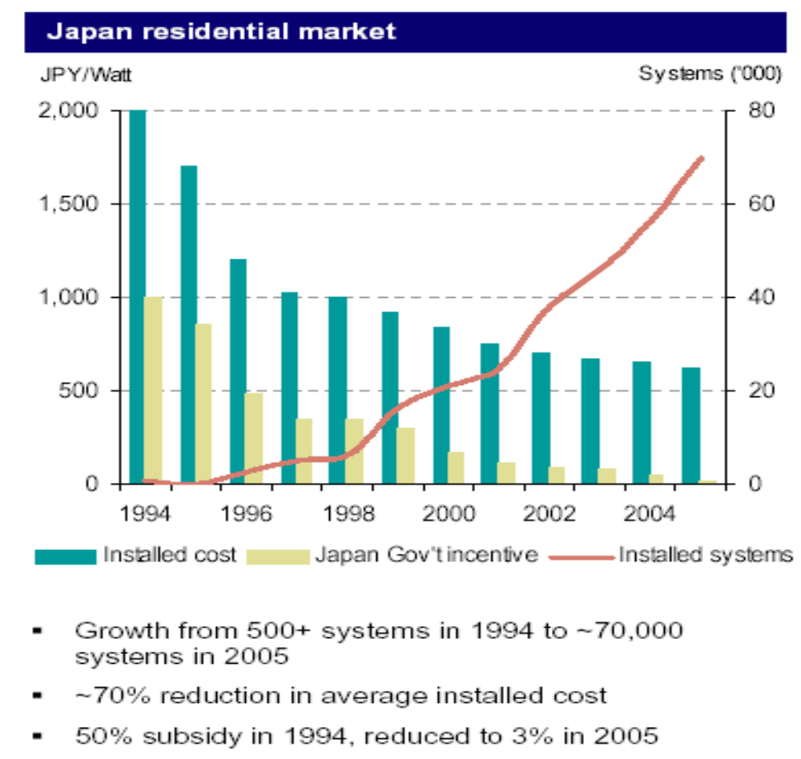
Public incentives are important

Slide 21
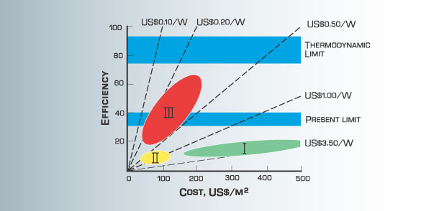
Cost goals for third generation solar cells
Efficiency and cost projections for first-, second- and third generation photovoltaic technology (wafers, thin-films, and advanced thin-films, respectively)
Source: University of New South Wales

Slide 22
Next generation technology
Silicon nanostructures
Bandgap engineering of silicon.
Applications could be tandem solar cells and energy selective contacts for hot carrier solar cells.
Fabrication of silicon nanostructures consisting of quantum well and quantum dot super lattices to achieve band gap control

Slide 23
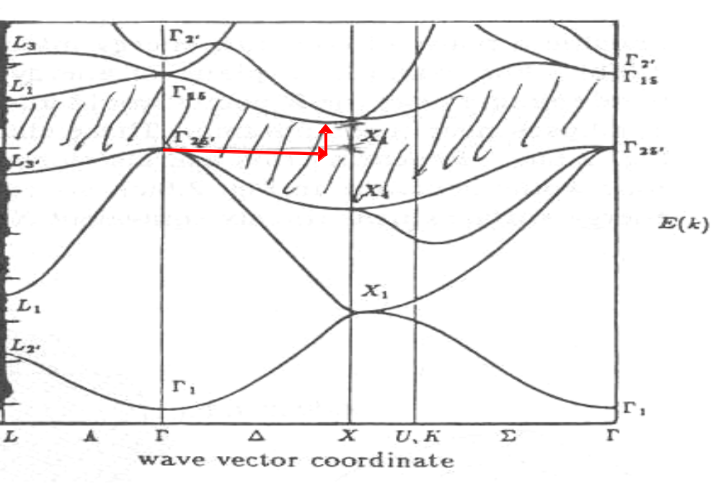

The energy band structure for silicon

Slide 24
Next generation technology (cont.)
Up/Down converters
Luminescent materials that:
EITHER absorb one high energy photon and emit more than one low energy photon just above the bad gap of the solar cell (down-conversion)
OR that absorb more than one low energy photon below the band gap of the cell and emit one photon just above the band gap (up-conversion).

Slide 25
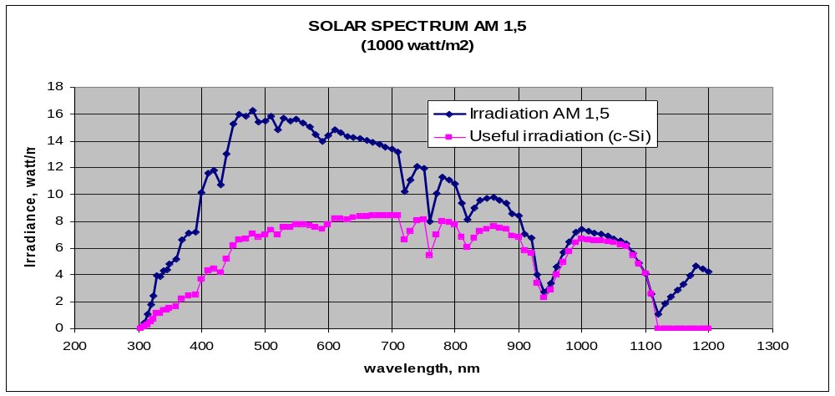
Understanding cell efficiency

Slide 26
Next generation technology (cont.)
Hot carrier Cells
This concept tackles the major PV loss mechanism of thermalisation of carriers.
The purpose is to slow down the rate of photoexcited carrier cooling caused by phonon interaction in the lattice to allow time for the carriers to be collected whilst they are still hot, and hence increasing the voltage of a cell.

Slide 27
Next generation technology (cont.)
Thermoelectric solar cells
Application of the concept of energy –selective electron transport used in hot carrier solar cells, to develop thermo electrics and thermo-ionics devices.

Slide 28
Conclusions
Solar energy will become the most important and cost-efficient energy source in the future.
The present lack of silicon feedstock is promoting a rapid development of next generation technology.
Immediate actions are taken to cut thinner wafers and increase cell efficiencies for crystalline silicon.
New thin film technologies are being developed
Stronger influence from semiconductor industry will accelerate the development of better technologies
Nanosilicon and other third generation technologies may offer a long-term solution for the future solar energy technology.

Slide 29
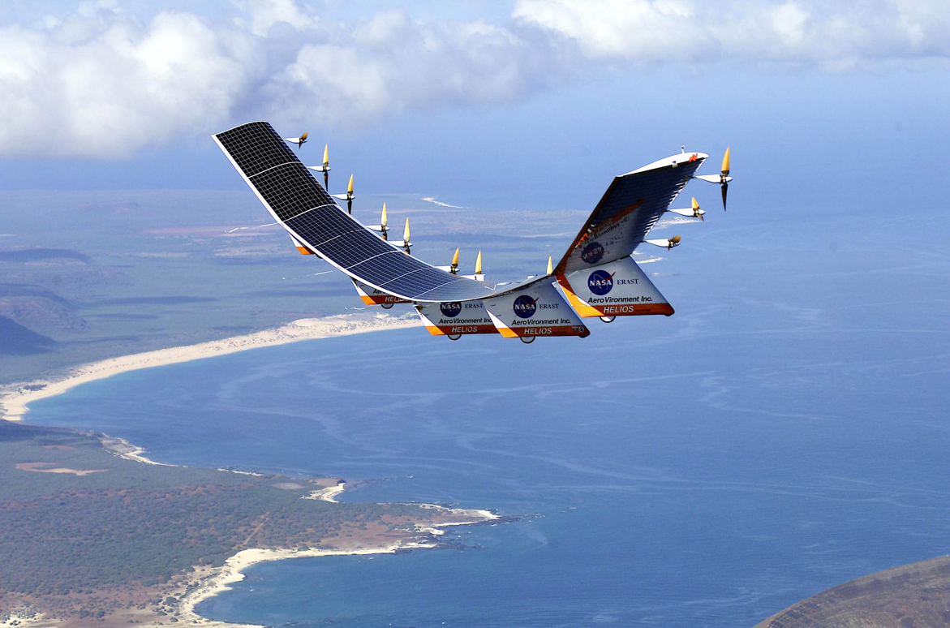
Thank you for your attention
The Photovoltaic industry has taken off…

Slide 30
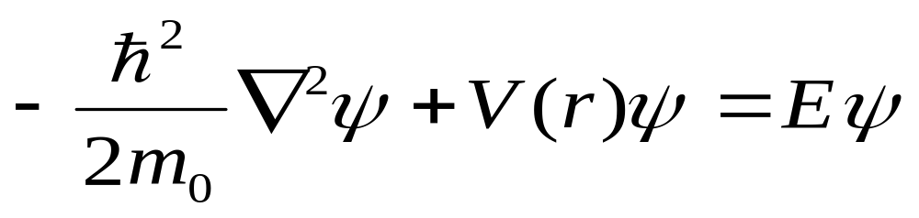
Schrödinger wave equation

Slide 31
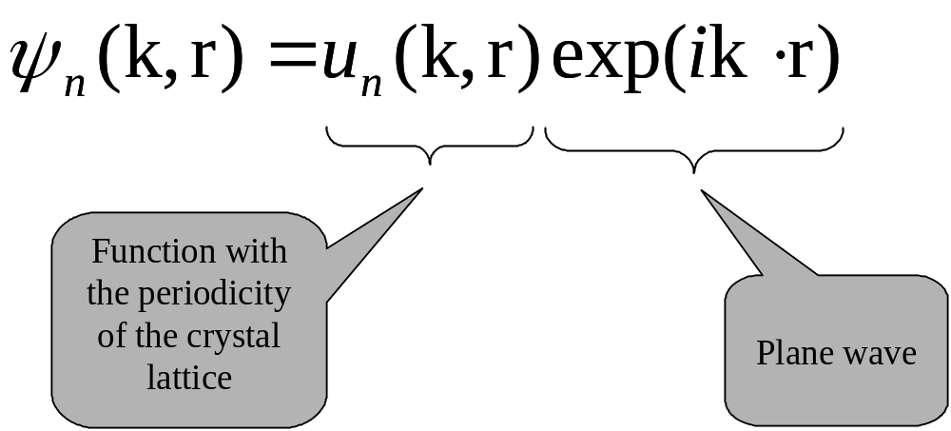
Solving Schrödinger equation; use of Bloch functions

Slide 32
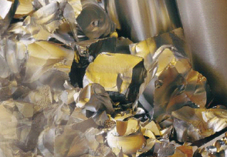
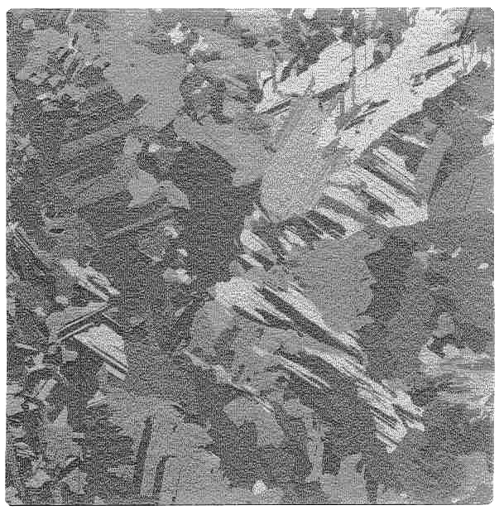
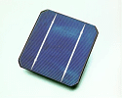
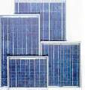
The PV Value Chain (multi-crystalline)
Polysilicon
Wafer
Solar Cell
Solar Module
Systems
Chemical Process
(purification)
Casting
Cutting
Surface Treatment
Assembly
Installation
Operation

Slide 33
California solar initiative installations and rebate level targets (2006E- 2016E)
700
3
600
2.5
500
2
MW
400
Dollars per watt
1.5
300
Installations:
Total 2600 MW
Rebate Level
1
200
0.5
100
0
0
2006
2007
2008
2009
2010
2011
2012
2013
2014
2015
2016
Source: California Public Utilities Commission

Slide 34
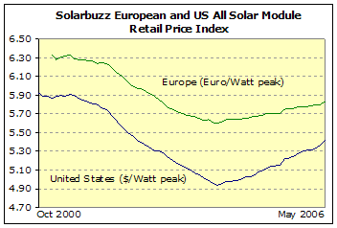
Prices are actually increasing

